Slide 1
AI4ALL 2021 - Lecture 03
Computation and
Python Part 1
Anthony Corso
June 30th 2021

Slide 2
Outline
A brief history of computation
Programming! A Python tutorial
Algorithms (Let’s make a PB&J)

Slide 3
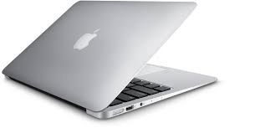
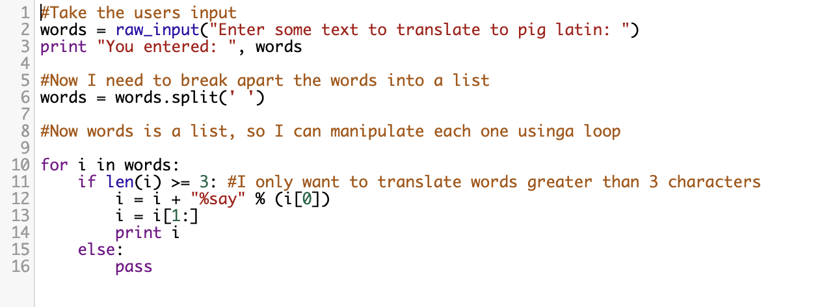
What is a computer?
Computation is the process of performing mathematical operations
A Computer is any machine that computes
A Program is a set of instructions that a computer runs

Slide 4
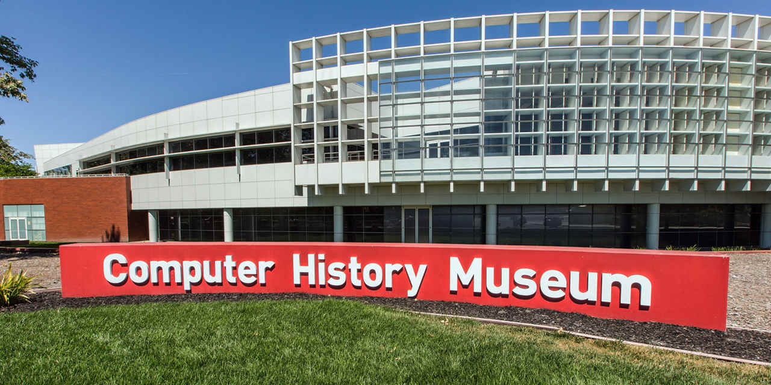
A Brief History of Computation

Slide 5
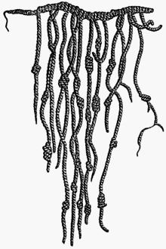
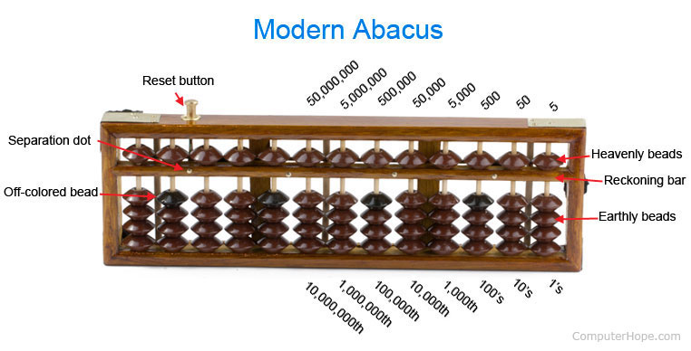
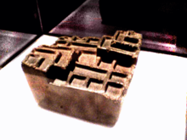
History of computation
Representation of an Inca quipu
Abacus
Invented approximately 3000 BC
A yupana as used by the Incas.

Slide 6
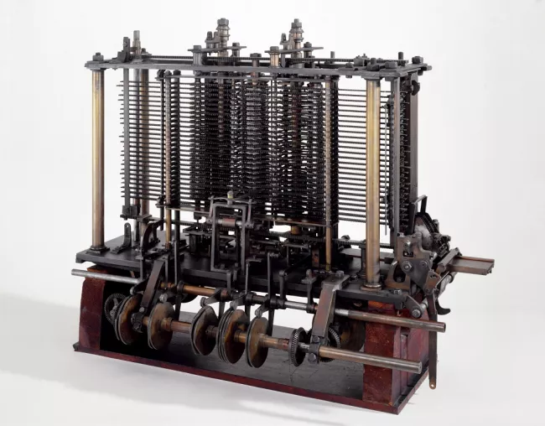
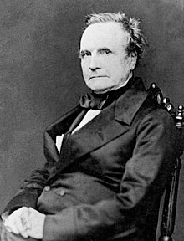
Automatic computing engines
Charles Babbage
(1791-1871)
The Babbage Engine
Notes:
A mathematician, philosopher, inventor and mechanical engineer, Babbage originated the concept of a digital programmable computer.^{[2]}
Turned by a crank and could compute tables of numbers that were useful to engineers and scientists

Slide 7
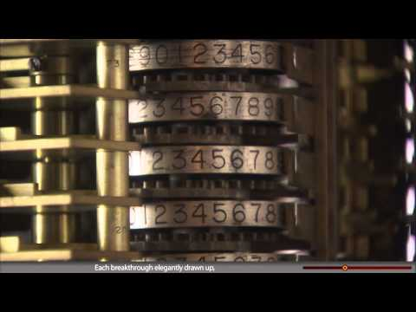
Automatic computing engines

Slide 8
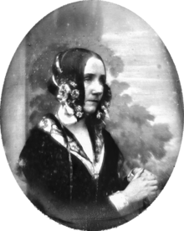
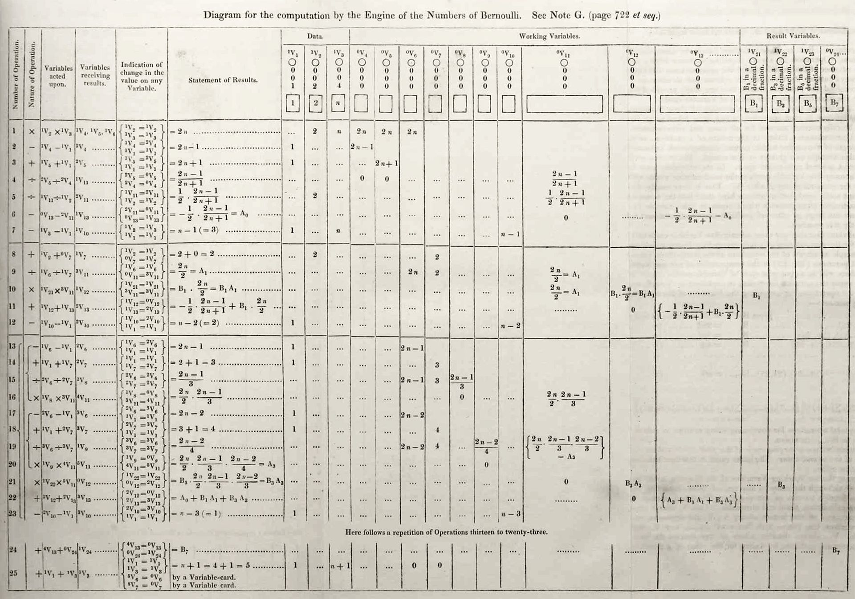

The first computer programmer!
Ada Programming Language
Lovelace's diagram, the first published computer algorithm
Ada Lovelace
(1815 - 1852)

Slide 9
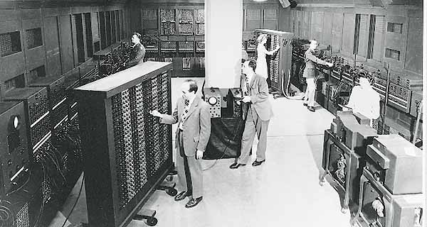
The first electronic general-purpose computer
ENIAC 1945
Electronic Numerical Integrator and Computer
Notes:
It was Turing-complete, and able to solve "a large class of numerical problems" through reprogramming

Slide 10
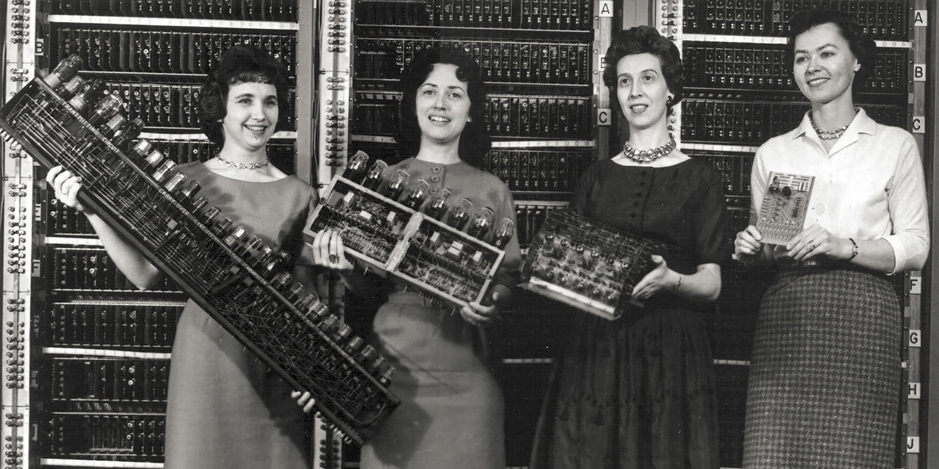
First programmers of ENIAC
Kay McNulty, Betty Jennings, Betty Snyder, Marlyn Meltzer, Fran Bilas, and Ruth Lichterman
were the first programmers of the ENIAC
Notes:
plugboard wiring and three portable function tables (containing 1200 ten-way switches each).^{[33]} The task of taking a problem and mapping it onto the machine was complex, and usually took weeks. Due to the complexity of mapping programs onto the machine, programs were only changed after huge numbers of tests of the current program.^{[34]} After the program was figured out on paper, the process of getting the program into ENIAC by manipulating its switches and cables could take days. This was followed by a period of verification and debugging, aided by the ability to execute the program step by step. A programming tutorial for the modulo function using an ENIAC simulator gives an impression of what a program on the ENIAC looked like.^{[35][36]}

Slide 11
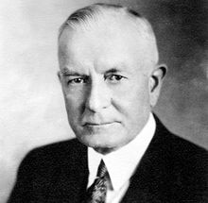
Modern Computers
"I think there is a world market for maybe five computers"
-- Thomas J. Watson, CEO and chairman of IBM, said in 1943

Slide 12
Discussion
Why do you think Watson made such a prediction?
What made Watson’s prediction wrong?
Are people still making these kind of predictions today for AI or other technologies?
"I think there is a world market for maybe five computers"
-- Thomas J. Watson, CEO and chairman of IBM, said in 1943

Slide 13
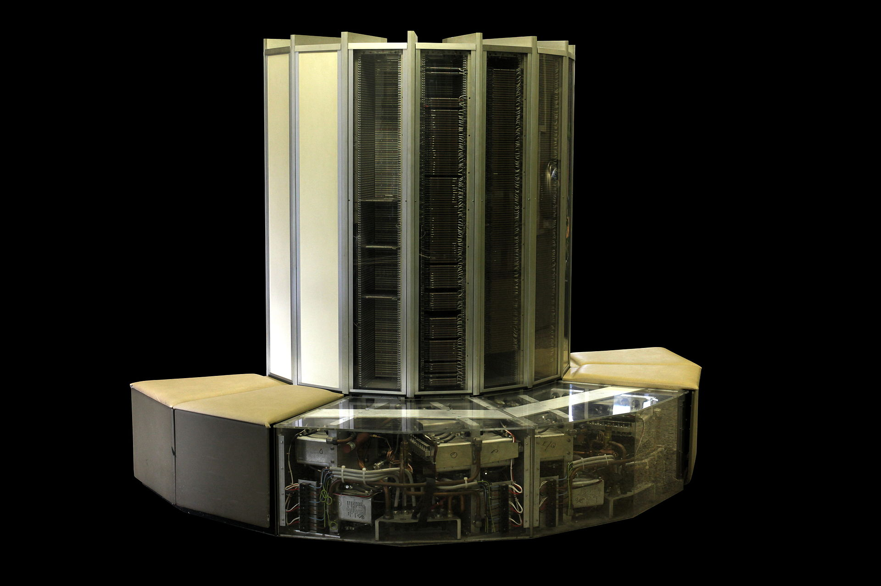
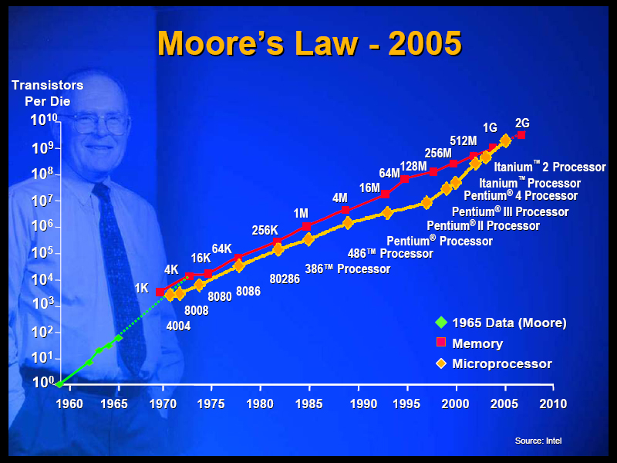
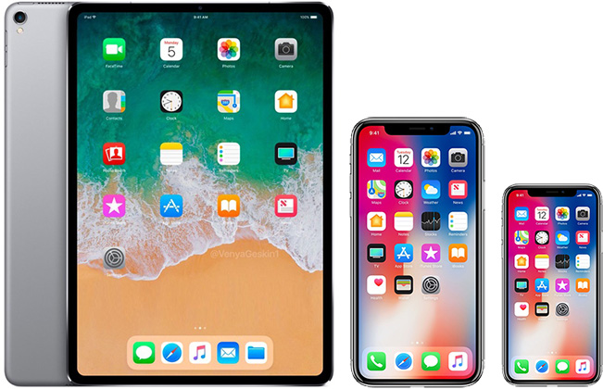
Modern Computers
Notes:
"640K of memory should be enough for everyone". - Bill gates

Slide 14
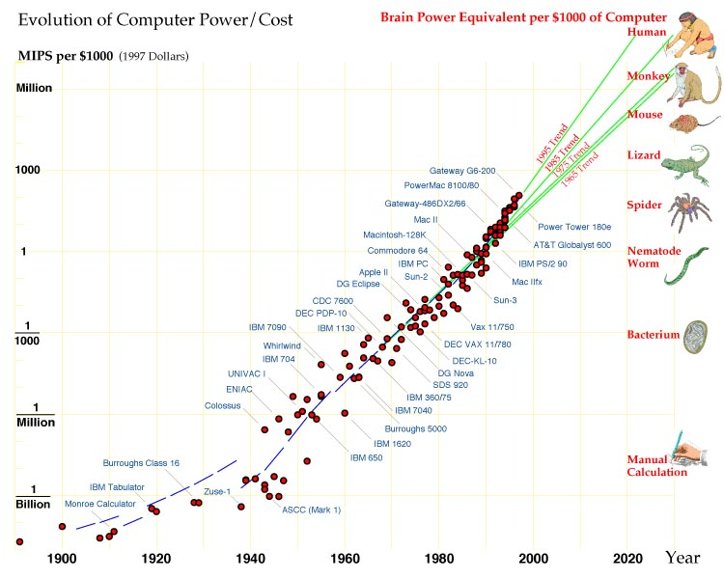

Slide 15
Discussion Question
When we reach the computational power of the human brain does that mean that AI will have human-level intelligence?

Slide 16
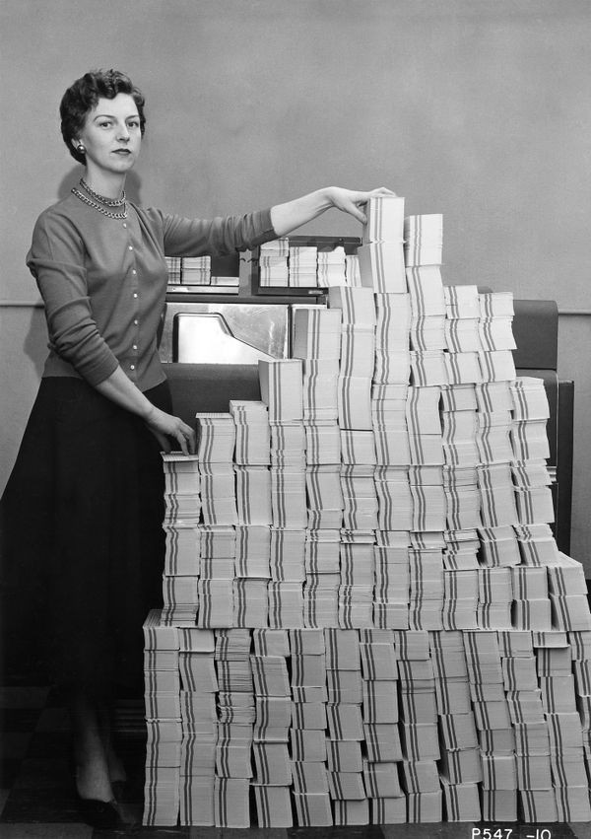
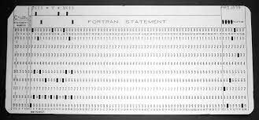
In the past what did programming look like?

Slide 17
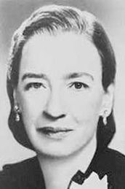
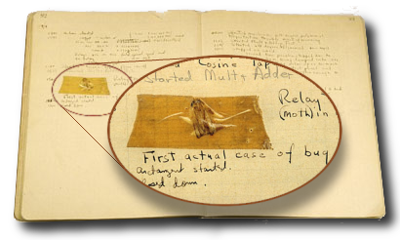
The first computer bug!
Log book with the first computer “bug”
National Museum of American History
Grace Hopper
(1906-1992)
Notes:
Among the team who found the first-reported computer bug was computer-language pioneer Grace Hopper.

Slide 18
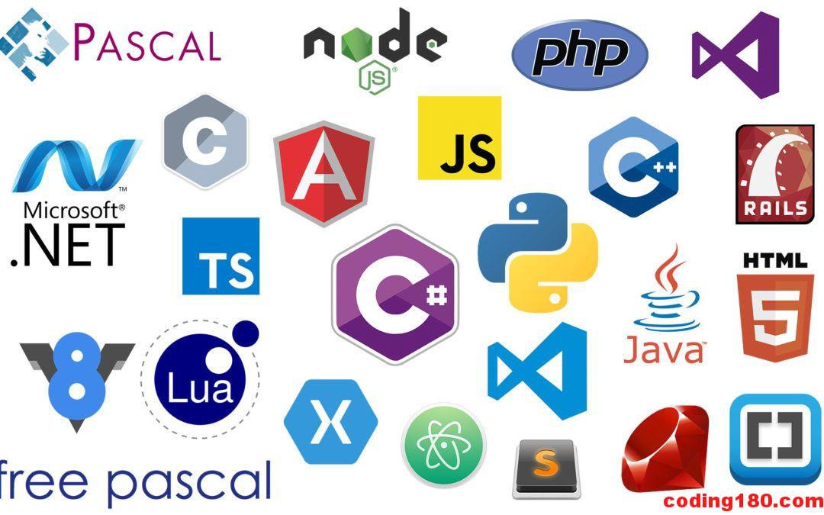
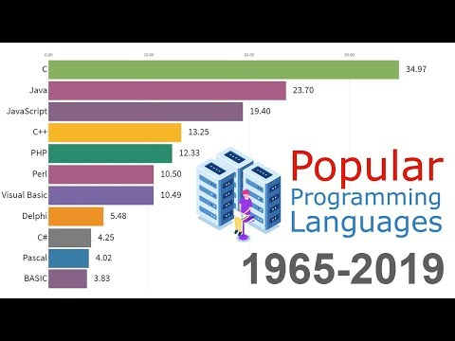
Programming Language

Slide 19
How do I learn programming?
Learn the basic concepts and syntax
Take lectures
Online study
Practice!
Examples and homeworks
Create your first project for fun
Debug, debug, debug
Read good source codes
Compare your solutions with others’
Code together with your friends
Open-source code online (GitHub)

Slide 20
Outline
A brief history of computation
Programming! A Python tutorial
Algorithms (Let’s make a PB&J)

Slide 21

Python
High-level, interpreted programming language

Slide 22
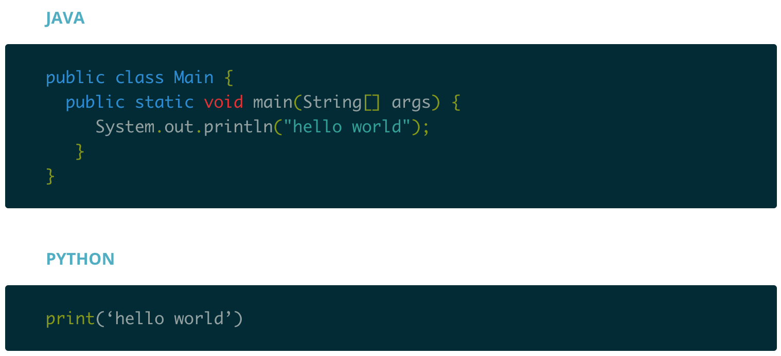
Why Python?
Python is high-level.

Slide 23
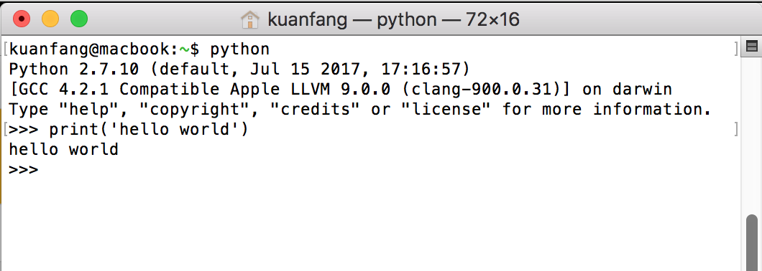
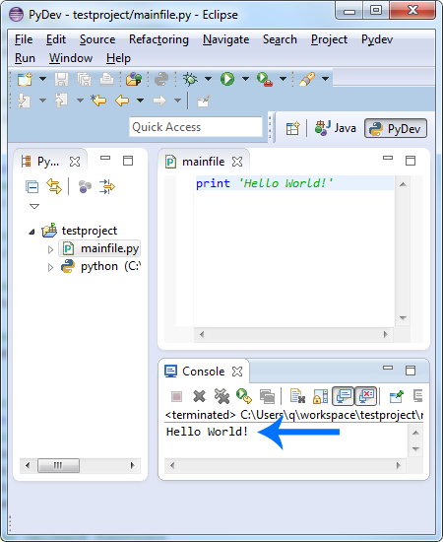
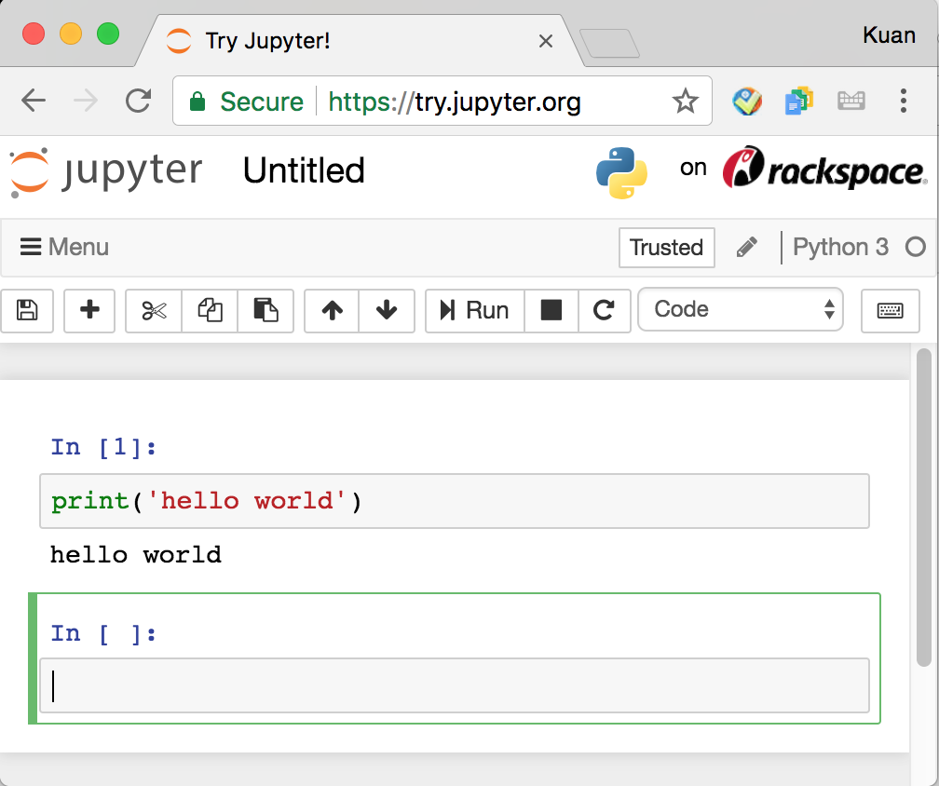
Why Python?
Python is accessible.
Interpreter/Terminal
IDE
Jupyter Notebook

Slide 24


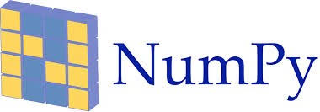








Why Python?
Python has many many awesome packages.

Slide 25
Setup Colab!

Slide 26
Types of Variables
Integers (e.g. 0, 1, 94305)
Floats (e.g. 0.1, 3.1415926)
Booleans (True, False, or None)
Strings (e.g. ‘Hello World!’)

Slide 27
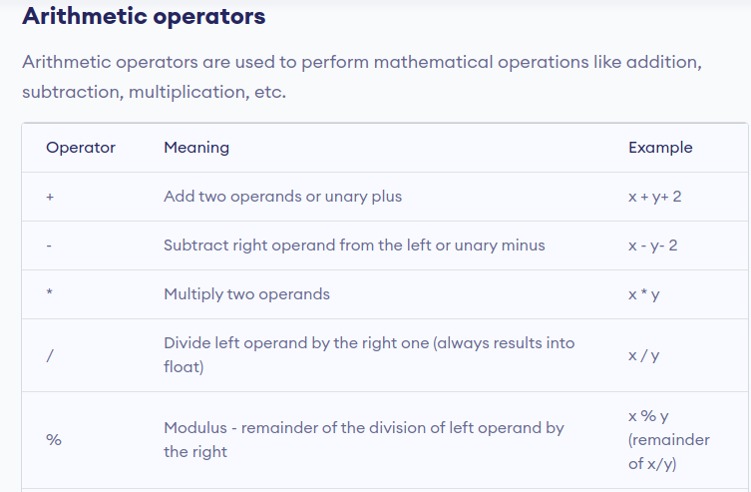
Operators

Slide 28
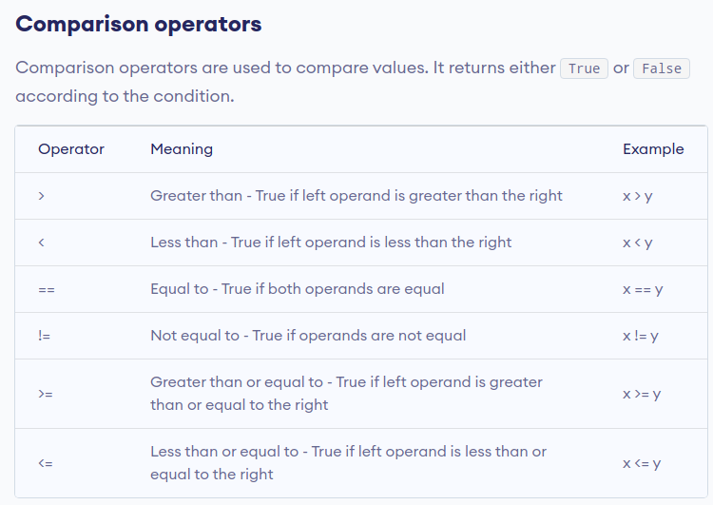
Operators

Slide 29
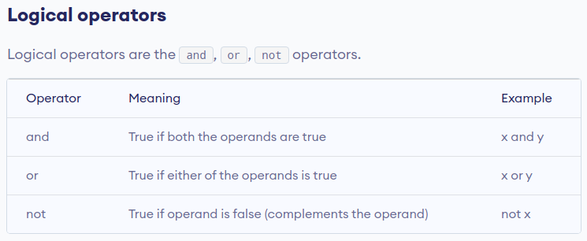
Operators

Slide 30
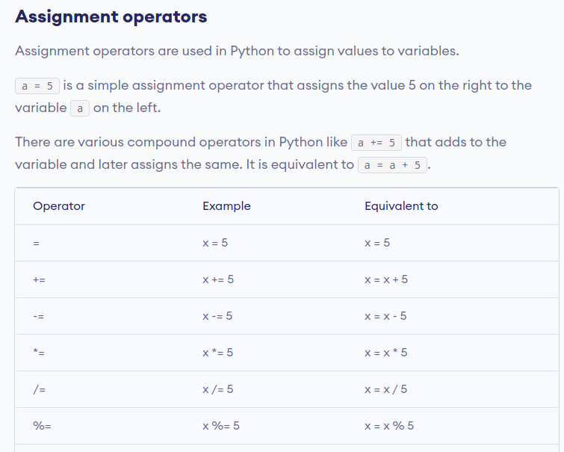
Operators

Slide 31
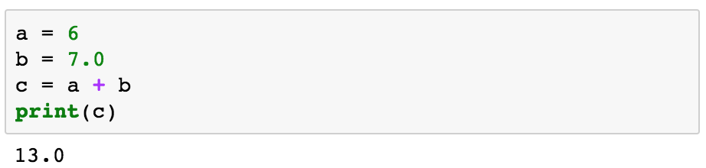
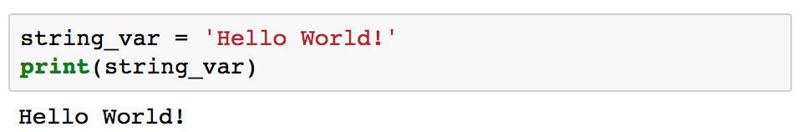
Each line is a statement

Slide 32
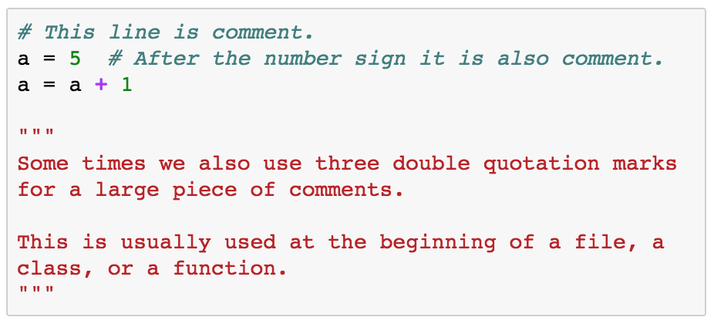
Comment

Slide 33
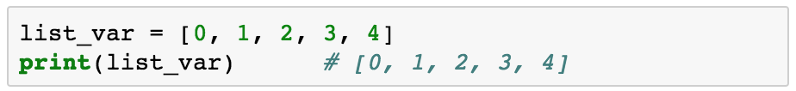
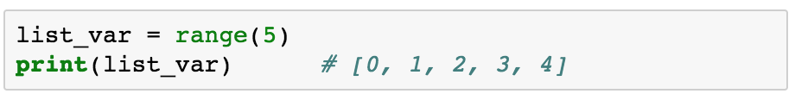
List

Slide 34
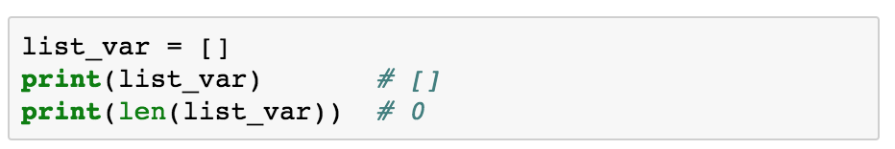
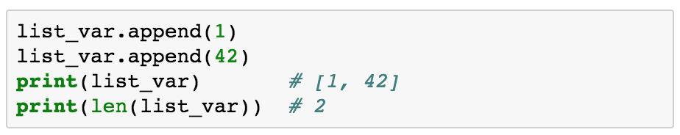
List
Notes:
Square Brackets

Slide 35
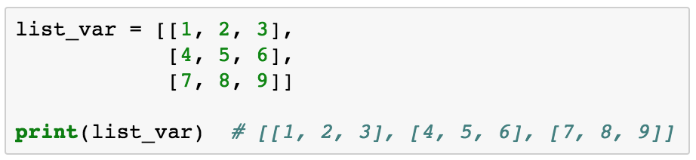
List

Slide 36
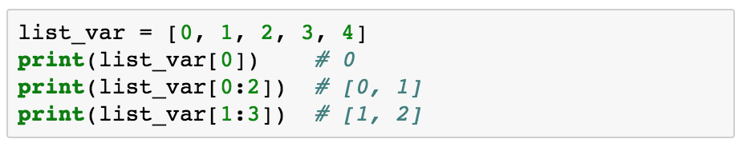
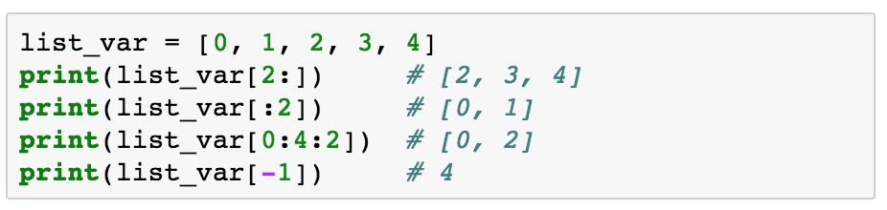
List Indexing

Slide 37
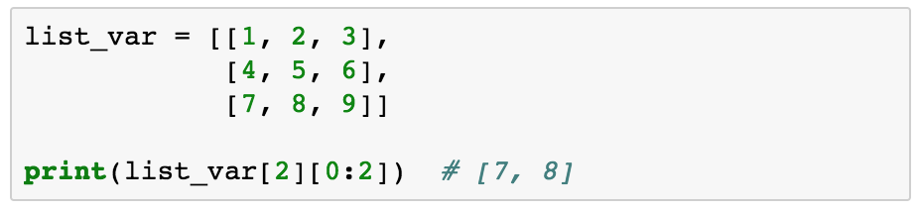
List Indexing

Slide 38
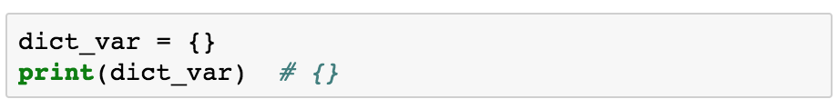
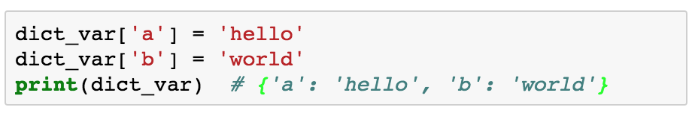
Dictionary (Similar to Map in Java/C++)
Notes:
Braces

Slide 39
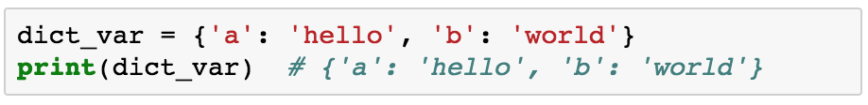
Dictionary

Slide 40
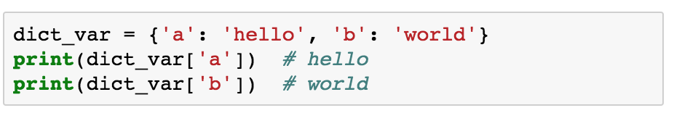
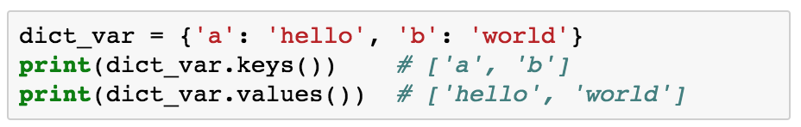
Dictionary Indexing

Slide 41
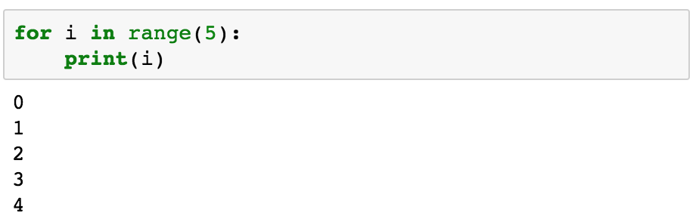
Control Flow

Slide 42

Control Flow

Slide 43
Outline
A brief history of computation
Programming! A Python tutorial
Algorithms (Let’s make a PB&J)

Slide 44


What is an algorithm?
A process or a set of rules to followed to perform a task

Slide 45

Lets make our own
Let’s instruct patrick, our very human-like computer, on how to make a peanut butter and jelly sandwich!

Slide 46
What is an algorithm for sorting any list of numbers from smallest to largest?
[19, 3, 1, 100, 7]

Slide 47
What is an algorithm for sorting any list of numbers from smallest to largest?
[19, 3, 1, 100, 7]
19

Slide 48
What is an algorithm for sorting any list of numbers from smallest to largest?
[19, 3, 1, 100, 7]
3 < 19?

Slide 49
What is an algorithm for sorting any list of numbers from smallest to largest?
[19, 3, 1, 100, 7]
3

Slide 50
What is an algorithm for sorting any list of numbers from smallest to largest?
[19, 3, 1, 100, 7]
1

Slide 51
What is an algorithm for sorting any list of numbers from smallest to largest?
[19, 3, 1, 100, 7]
1

Slide 52
What is an algorithm for sorting any list of numbers from smallest to largest?
[19, 3, 1, 100, 7]
1

Slide 53
What is an algorithm for sorting any list of numbers from smallest to largest?
[19, 3, 1, 100, 7]

Slide 54
What is an algorithm for sorting any list of numbers from smallest to largest?
[19, 3, 100, 7]
[1]
Output:

Slide 55
What is an algorithm for sorting any list of numbers from smallest to largest?
[19, 3, 100, 7]
[1]
Output:

Slide 56
What is an algorithm for sorting any list of numbers from smallest to largest?
[19, 100, 7]
[1, 3]
Output:

Slide 57
What is an algorithm for sorting any list of numbers from smallest to largest?
[19, 100, 7]
[1, 3]
Output:

Slide 58
What is an algorithm for sorting any list of numbers from smallest to largest?
[19, 100]
[1, 3, 7]
Output:

Slide 59
What is an algorithm for sorting any list of numbers from smallest to largest?
[19, 100]
[1, 3, 7]
Output:

Slide 60
What is an algorithm for sorting any list of numbers from smallest to largest?
[100]
[1, 3, 7, 19]
Output:

Slide 61
What is an algorithm for sorting any list of numbers from smallest to largest?
[100]
[1, 3, 7, 19]
Output:

Slide 62
What is an algorithm for sorting any list of numbers from smallest to largest?
[]
[1, 3, 7, 19, 100]
Output:

Slide 63
What is an algorithm for sorting any list of numbers from smallest to largest?
[]
[1, 3, 7, 19, 100]
Output:

Slide 64
Is Machine Learning an Algorithm?

Slide 65

I think so!
It is a very simple algorithm that can do really complex things!

Slide 66


Turing Machine and general-purpose computers
Alan Turing
(1912-1954)
Cartoon illustration of Turing Machine
Notes:
The turing machine is a model of a general purpose computer

Slide 67
Turing Machine and general-purpose computers
Turing Complete: A programming language is Turing complete, if given enough time it can solve any computational problem that a turing machine can.
AI Complete: A task is said to be AI Complete if it require human-level intelligence to solve it.
Notes:
For example: Let's say there is a program that takes 10 numbers and adds them. A Turing machine can easily run this program. But now imagine that for some reason your programming language can't perform the same addition. This would make it "Turing incomplete" (so to speak). On the other hand, if it can run any program that the universal Turing machine can run, then it's Turing complete. HTML and CSS are not turing complete programming languages

Slide 68
Discussion
Are these problems AI-complete? And why?
Language translation
Classifying the animal given an image
Passing the SAT
Autonomous driving
Captchas
Can you point out two other applications or problems you think are AI-complete?

